Slide 1
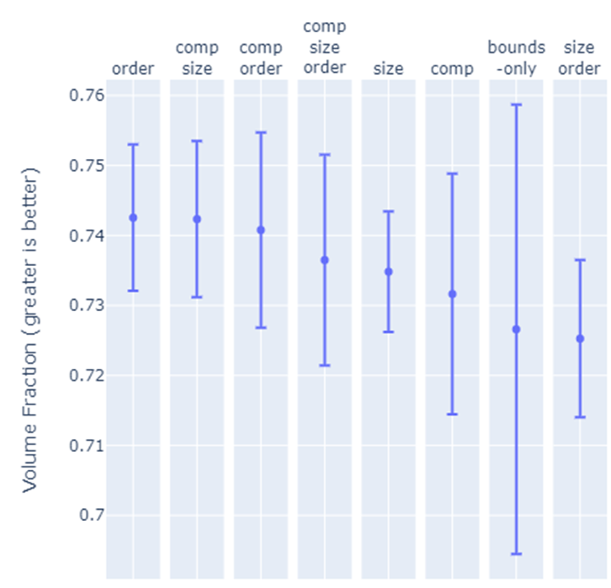
Average Num. Constraints | 2.5 |  |  |  | 1
Num. Constraints | 2 | 2 | 3 | 3 | 1 | 1 | 0 | 2

Slide 2
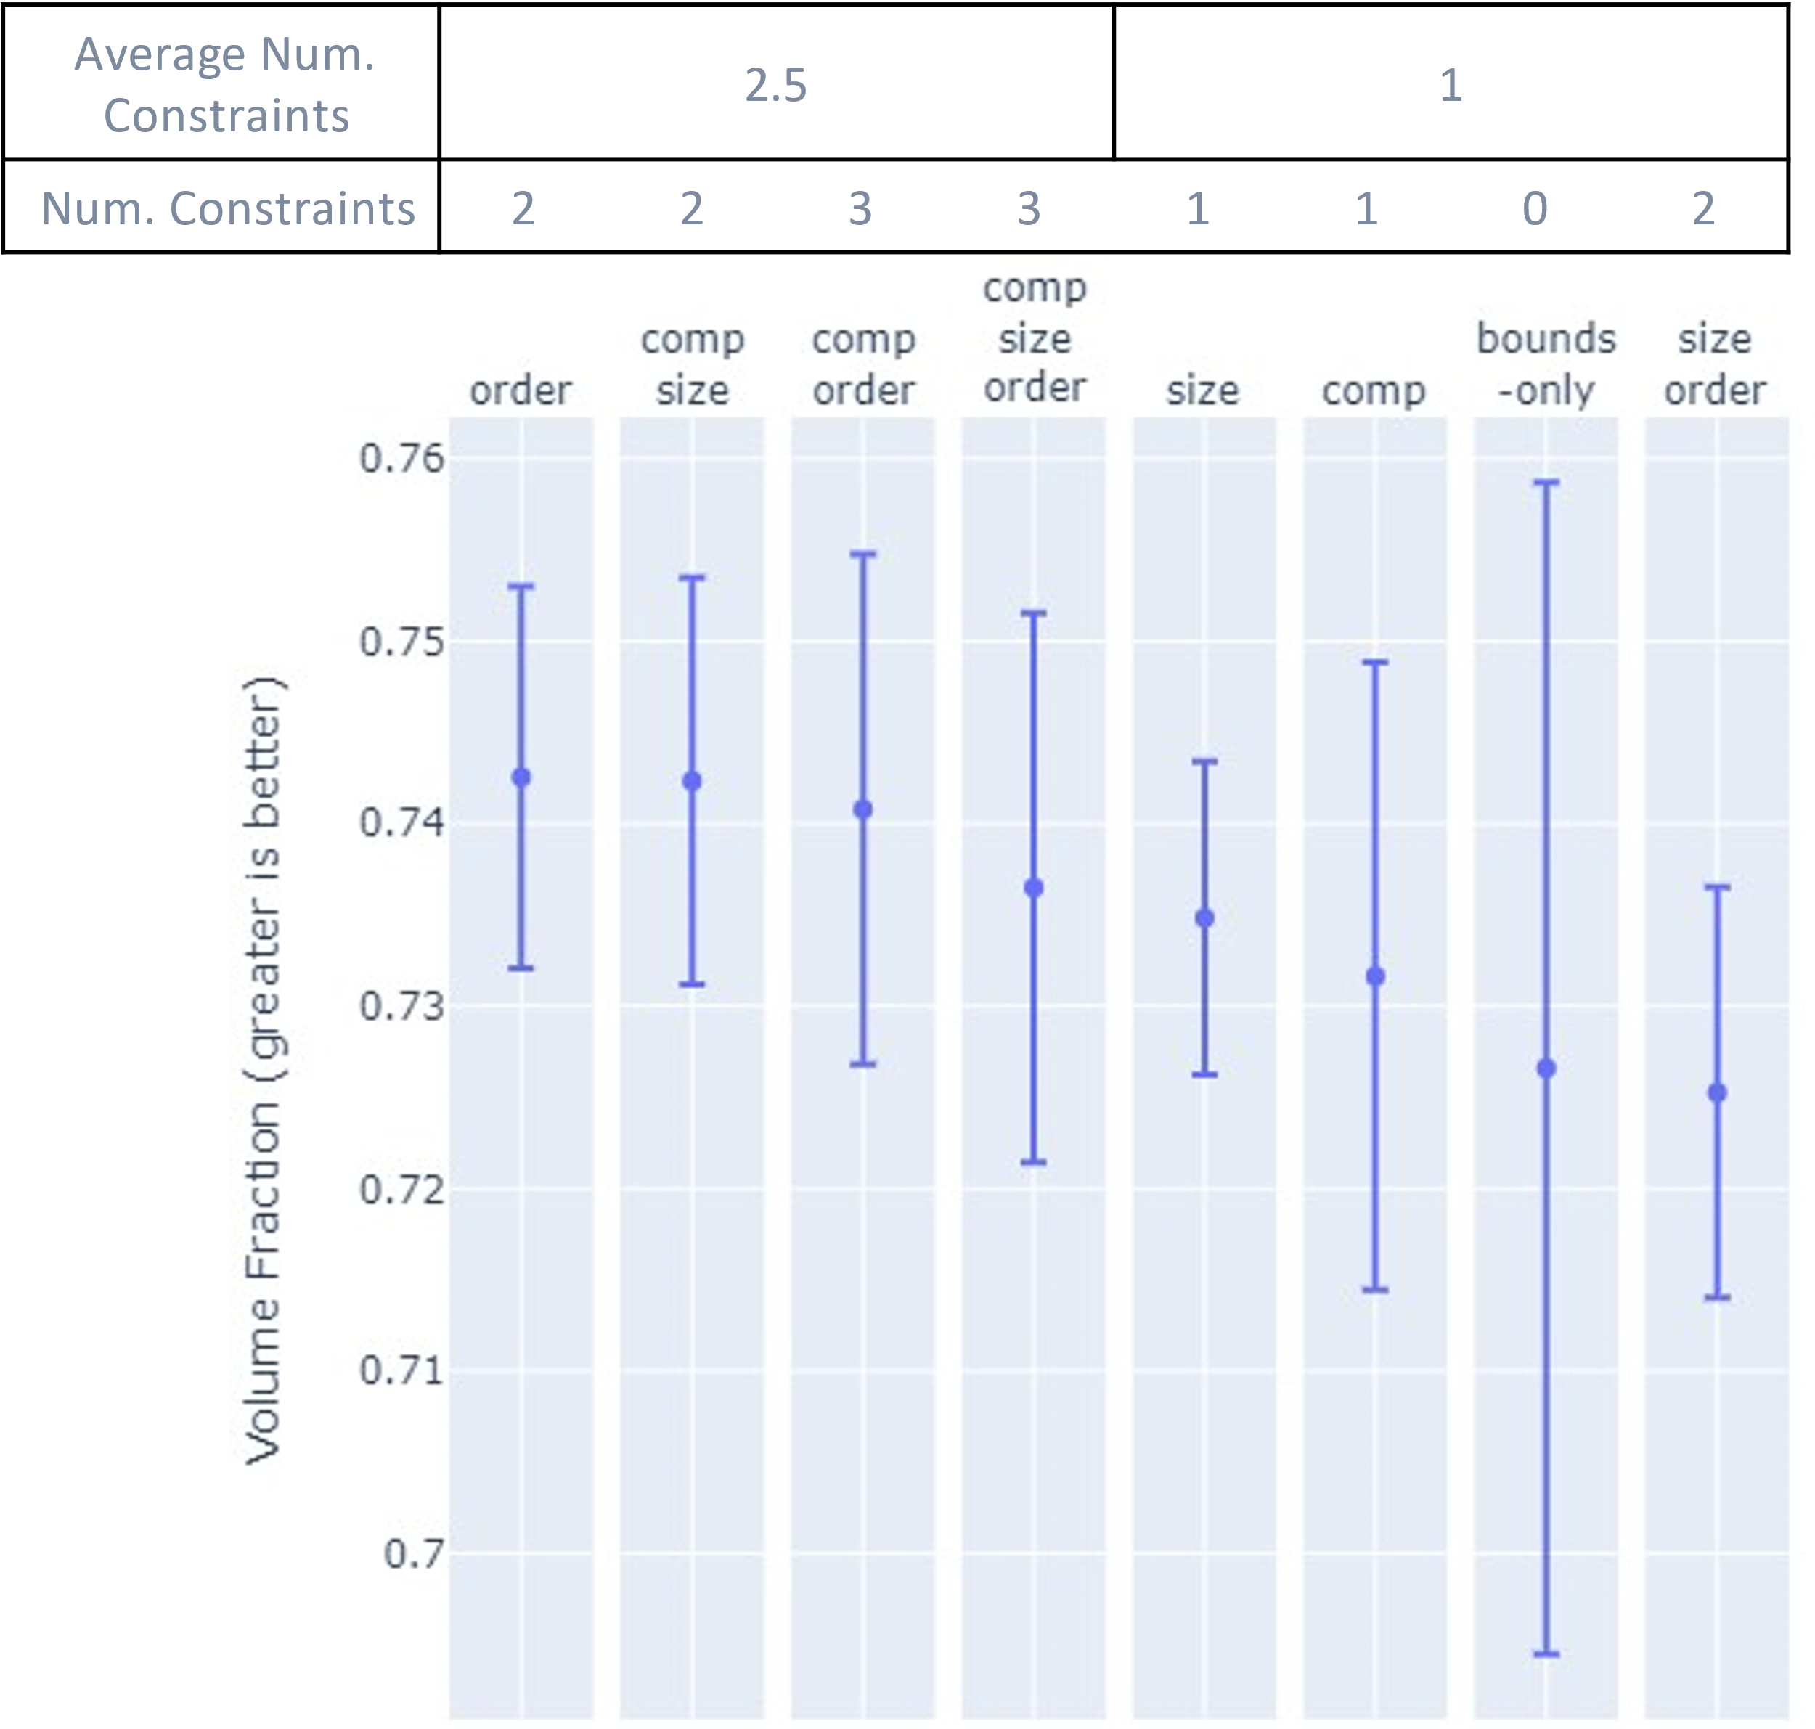

Slide 3
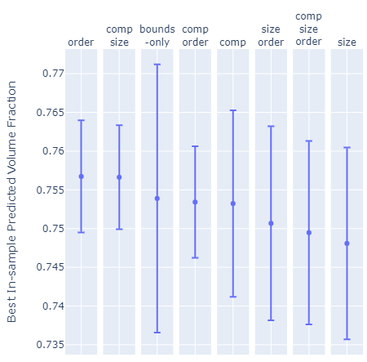
Average Num. Constraints | 1.75 |  |  |  | 1.75
Num. Constraints | 2 | 2 | 0 | 3 | 1 | 2 | 3 | 1

Slide 4
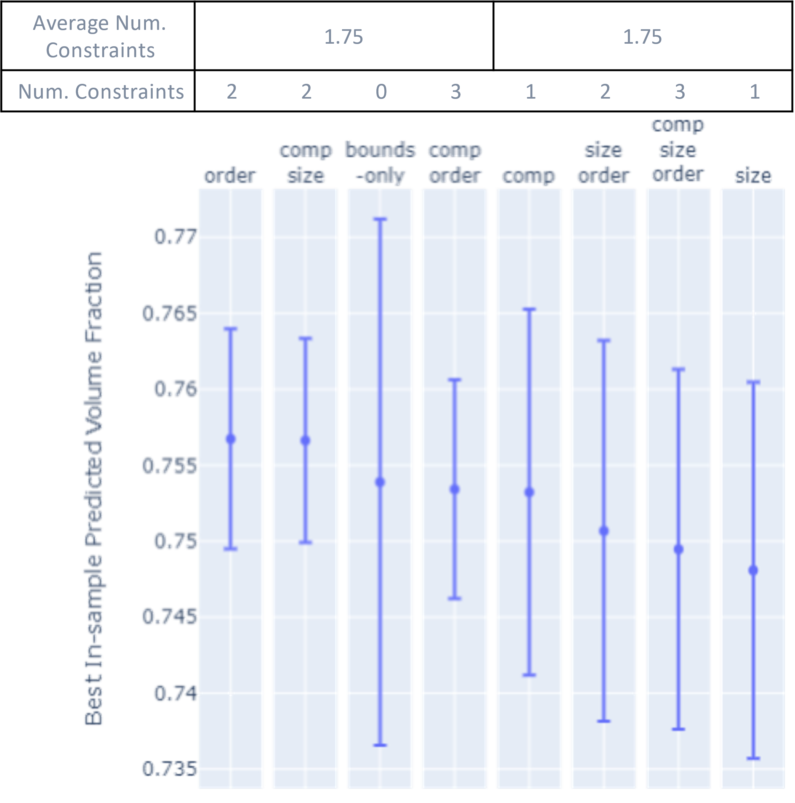

Slide 5
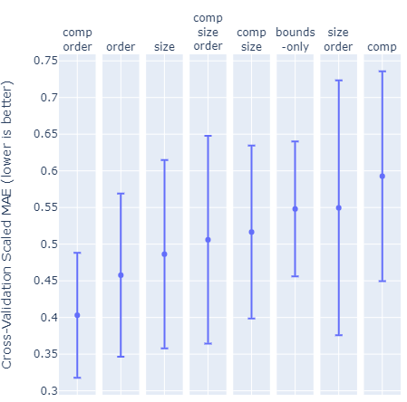
Average Num. Constraints | 2.25 |  |  |  | 1.25
Num. Constraints | 3 | 2 | 1 | 3 | 2 | 0 | 2 | 1

Slide 6
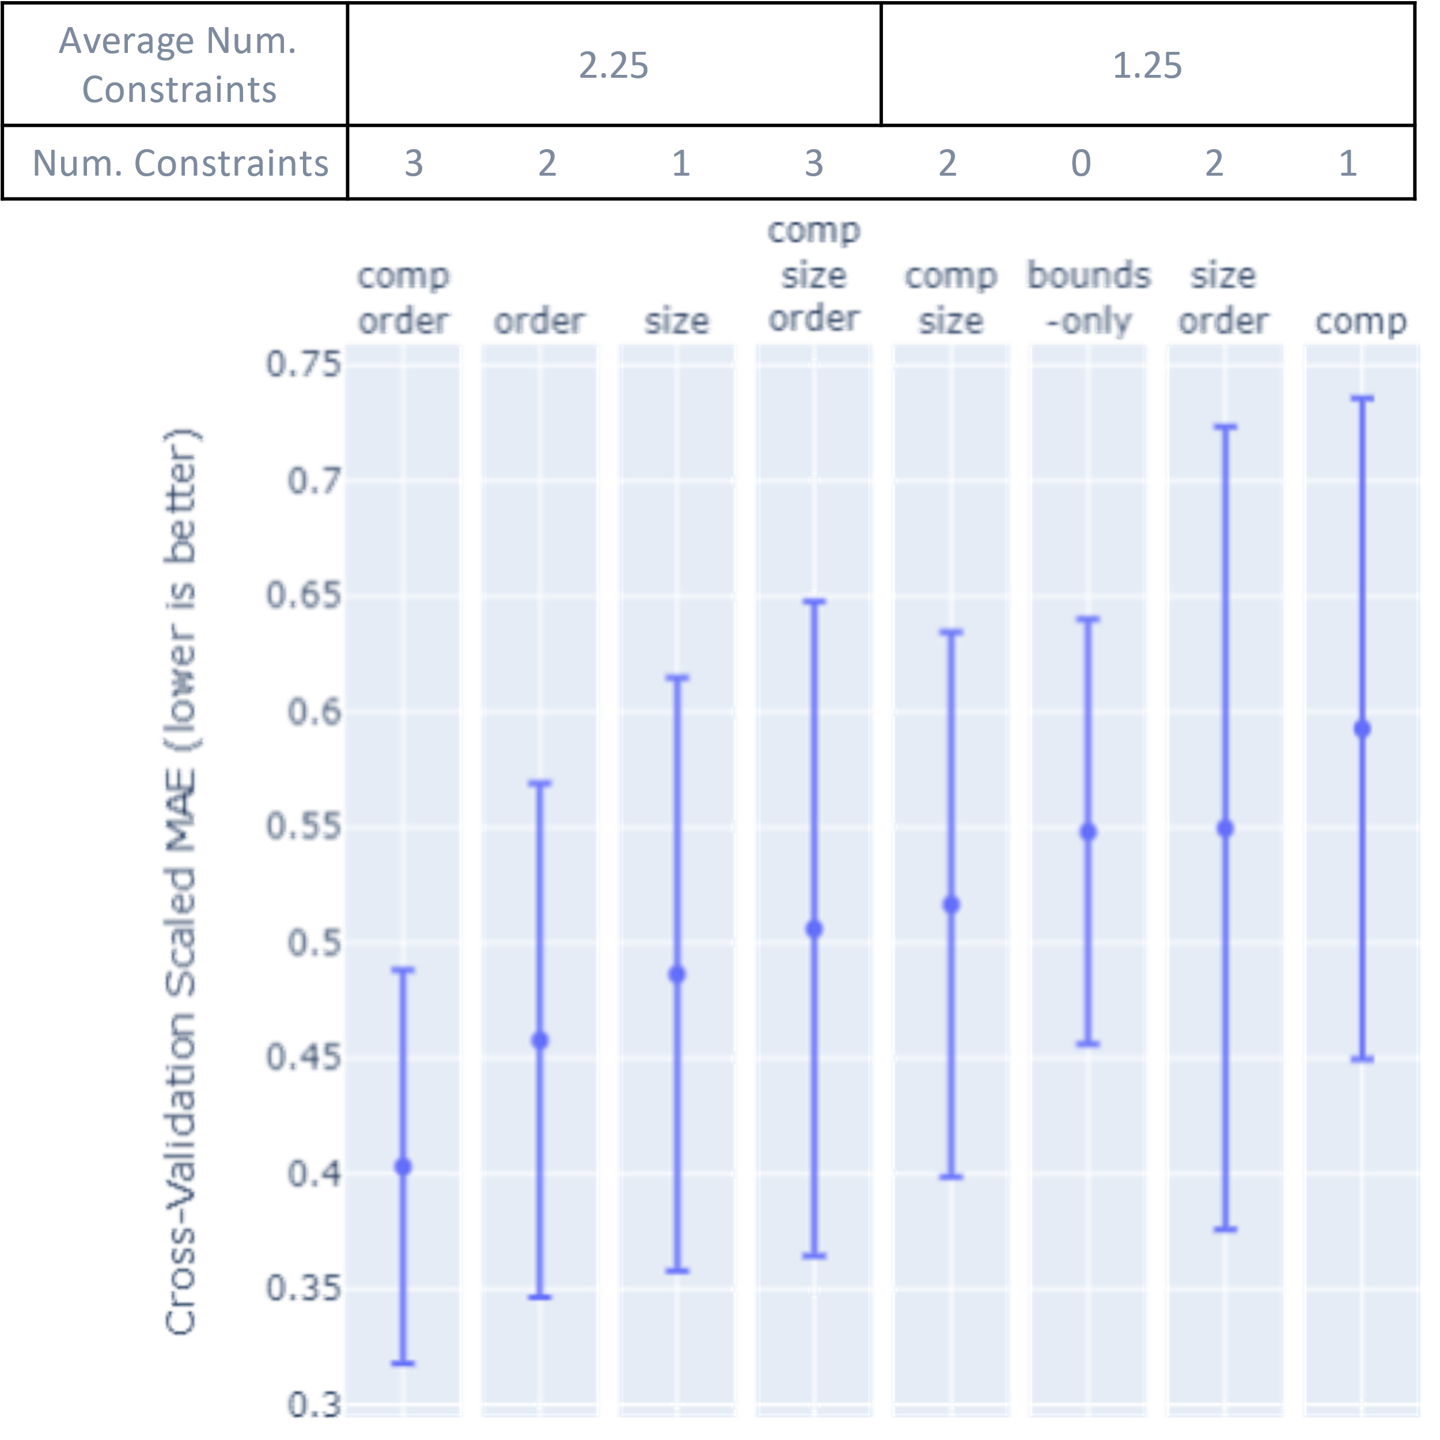

Slide 7
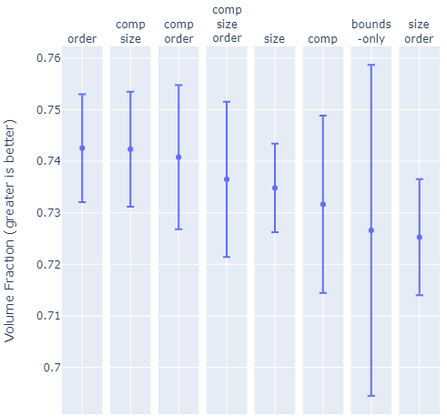
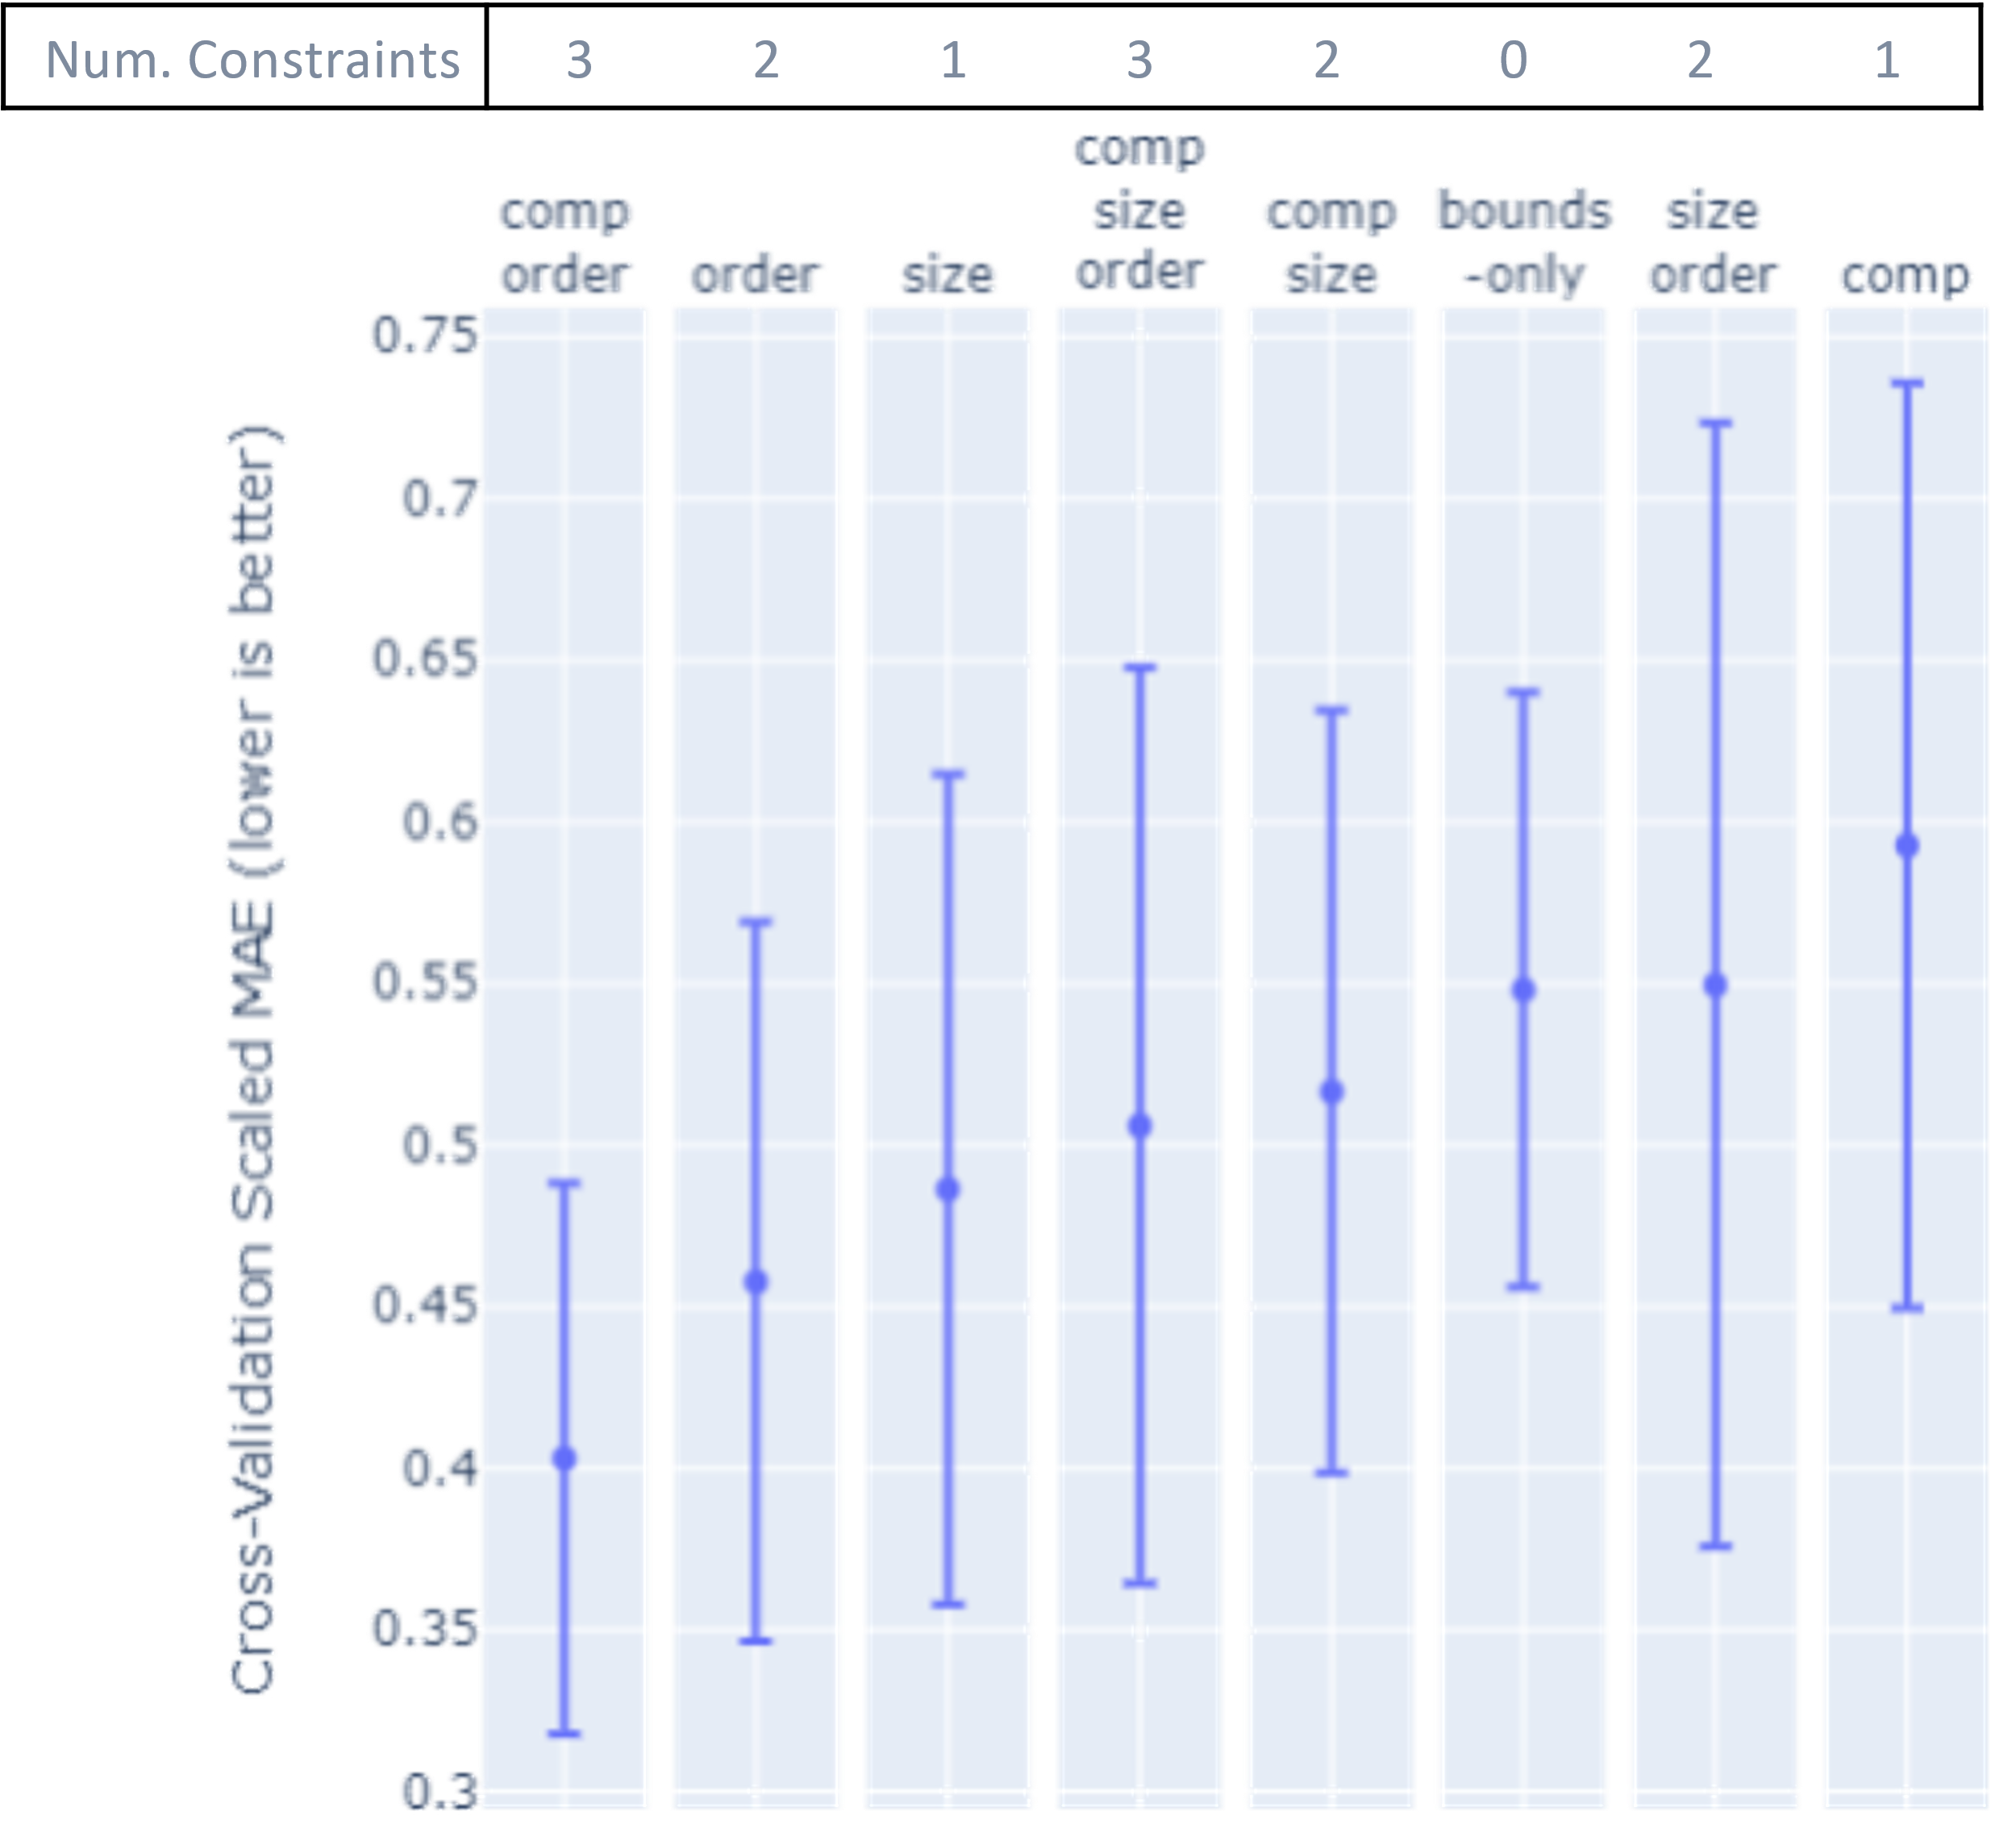
Average Num. Constraints | 2.5 |  |  |  | 1
Num. Constraints | 2 | 2 | 3 | 3 | 1 | 1 | 0 | 2
(a)
Num. Constraints | 2 | 2 | 3 | 3 | 1 | 1 | 0 | 2
(a)
Average Num. Constraints | 1.75 |  |  |  | 1.75
Num. Constraints | 2 | 2 | 0 | 3 | 1 | 2 | 3 | 1
(b)
Num. Constraints | 2 | 2 | 0 | 3 | 1 | 2 | 3 | 1
(b)
Average Num. Constraints | 2.25 |  |  |  | 1.25
Num. Constraints | 3 | 2 | 1 | 3 | 2 | 0 | 2 | 1
(c)
(c)

Slide 8
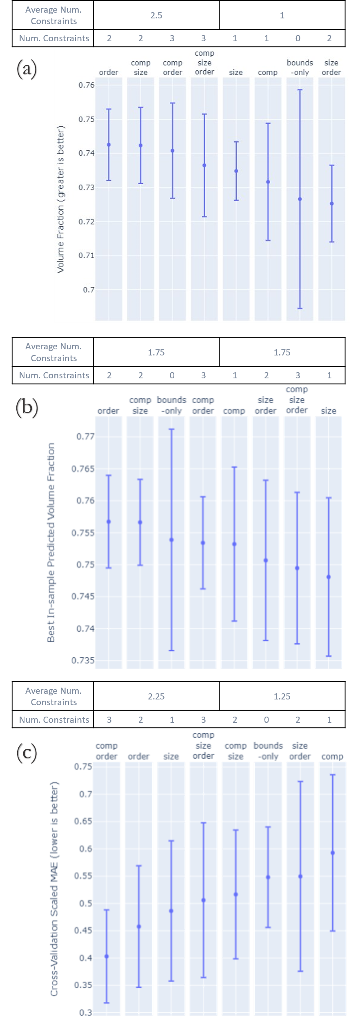

Slide 9


Slide 10


Slide 11
Maximize Packing Fraction via Constrained Bayesian Optimization
Original
Invariant
Size
Composition
Permutation

Slide 12
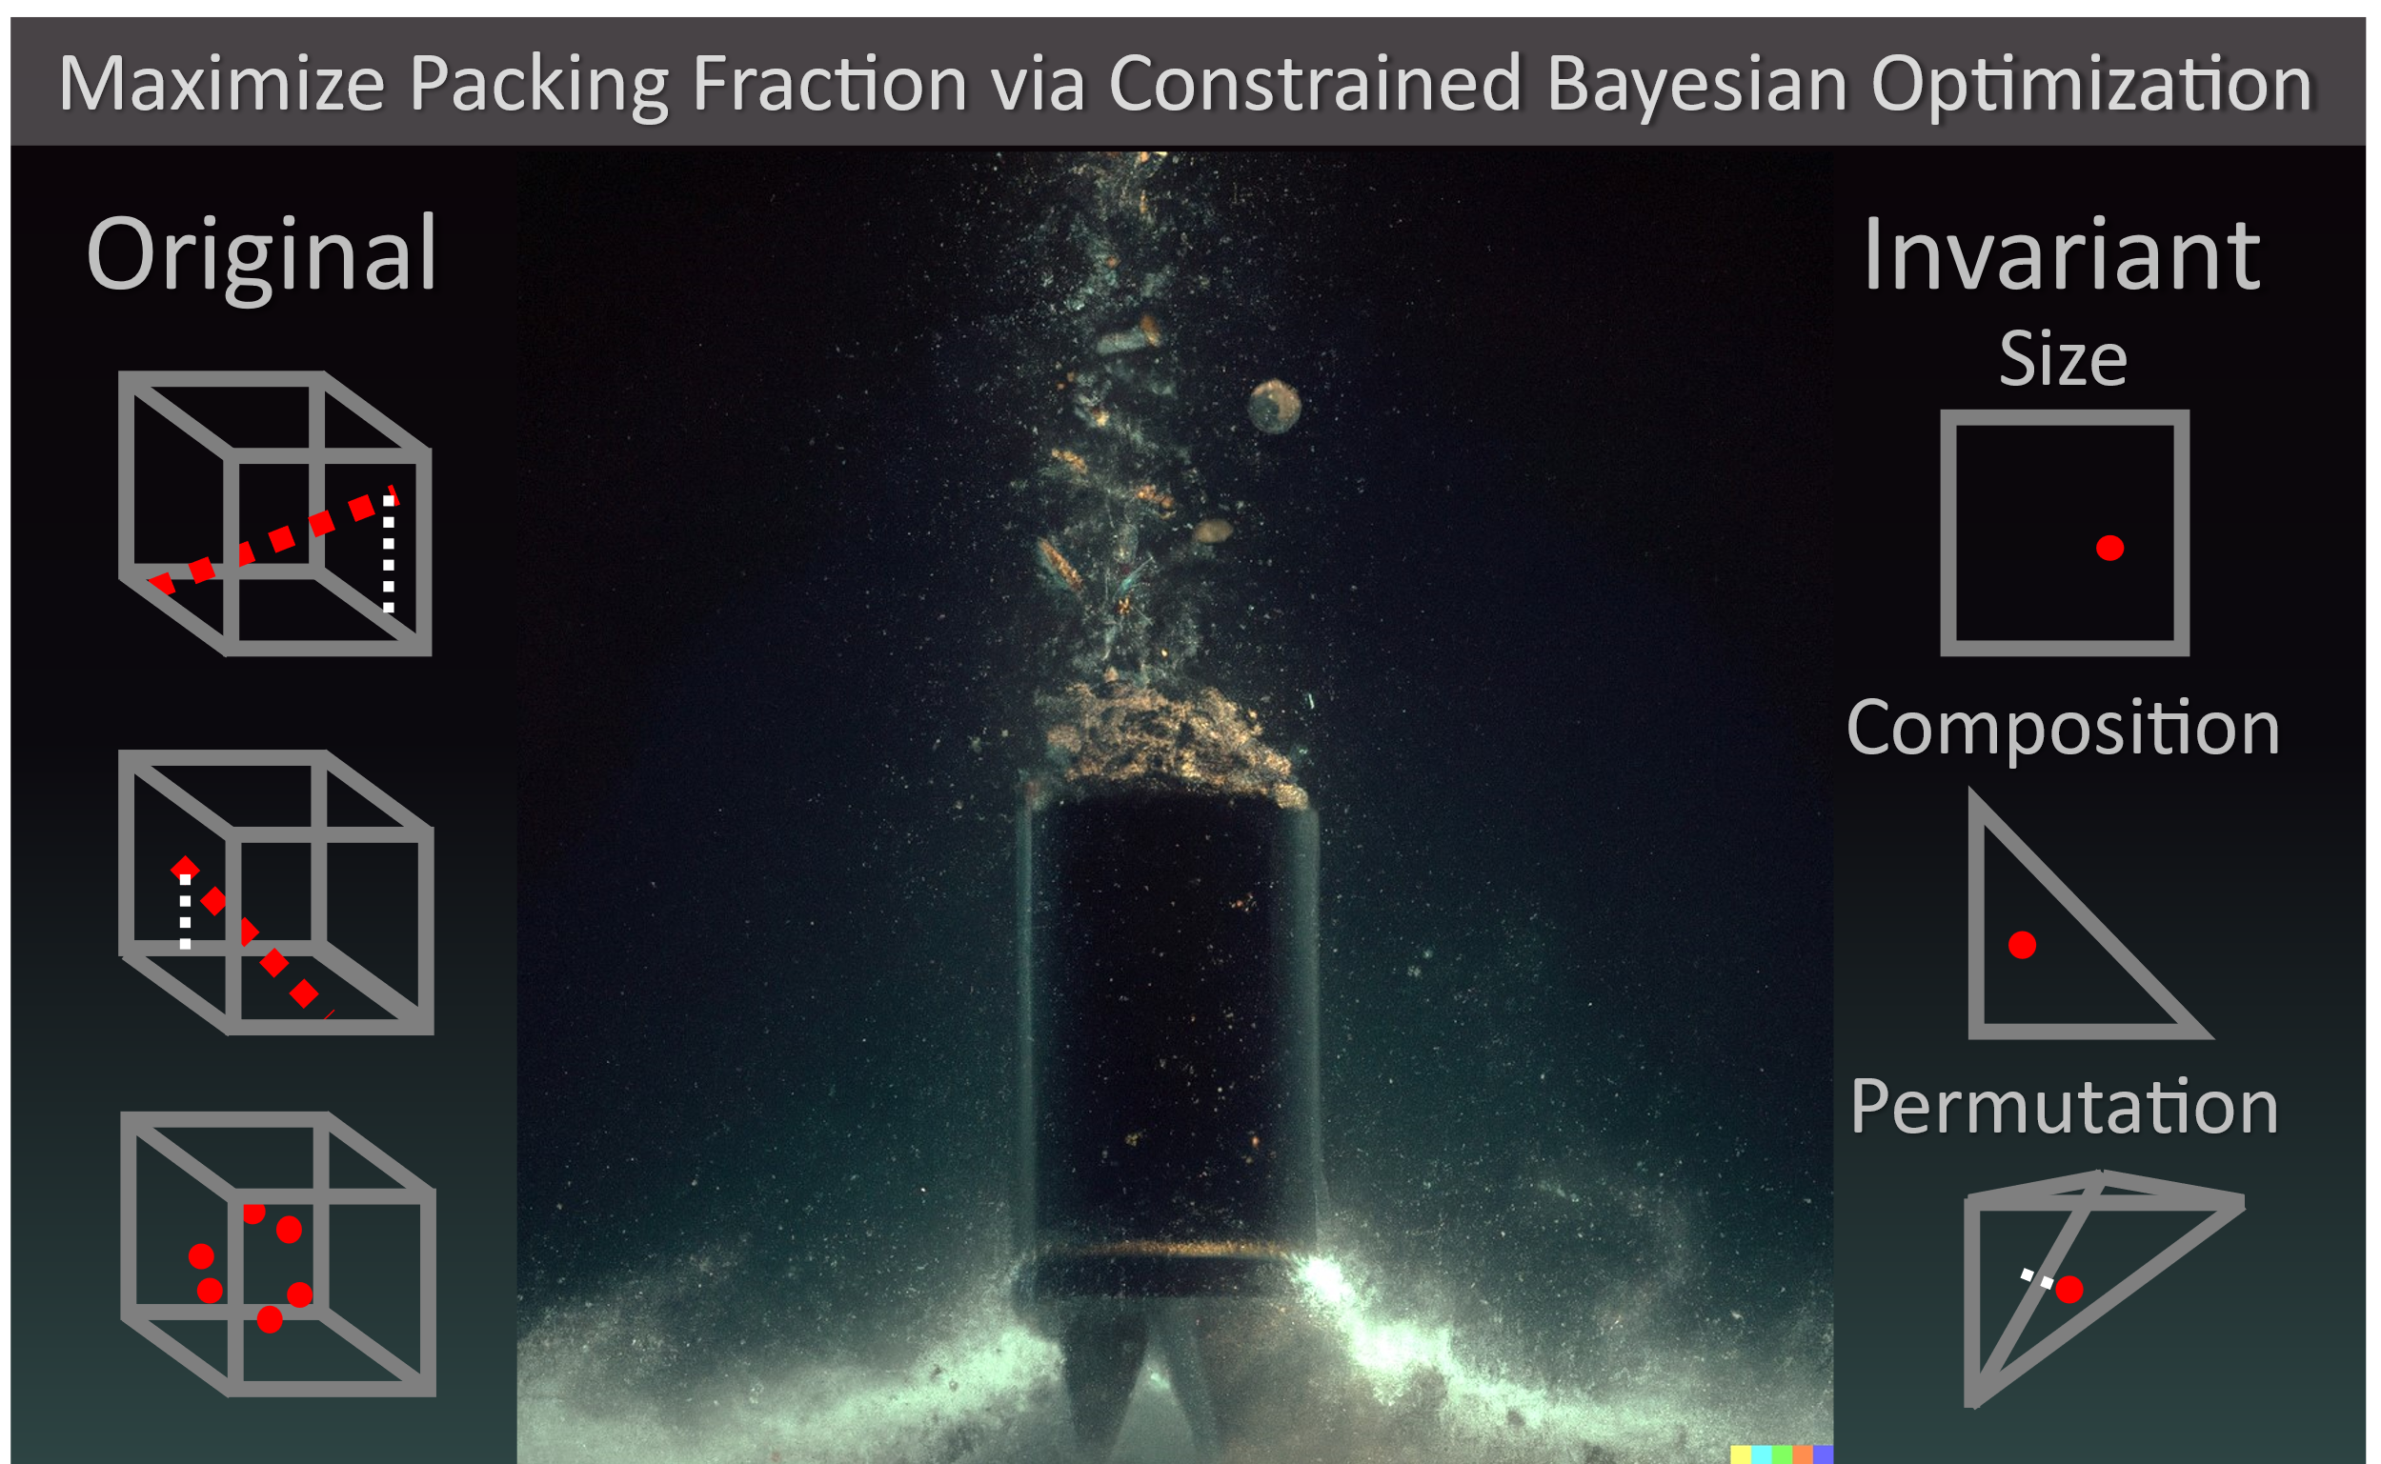

Slide 13
Maximize Packing Fraction via Constrained Bayesian Optimization
Original
Invariant
Composition
Permutation

Slide 14
